Slide 1
Introduction to the Microbiome

Slide 2
Quiz Questions

Slide 3
Learning Objectives
Describe the commensurable relationship between humans and microbes, including major location-dependent microbiomes on the human body.
Evaluate the stability and malleability of the microbiome, in relationship to genetic or life-course dependent changes.
Consider the environmental factors that shape the gut microbial niche, and how that affects the kinds of bacterial species that flourish. Use this information to predict how bacteria species may be altered by diet.
Evaluate the role of fiber in providing fuel to the microbiome. Using the physical properties of polysaccharides in fiber, explain why these nutrients are particularly important for microbial function.
Explain the methods by which the microbiome is assessed, including the strengths and weaknesses of each methodology.
Describe the relationship between the gut microbiome and the immune system.
Compare descriptive and interventional studies of microbiota-disease relationships and use this information to consider the strength of the relationship.

Slide 4
Introductory Video
https://www.ted.com/talks/rob_knight_how_our_microbes_make_us_who_we_are

Slide 5
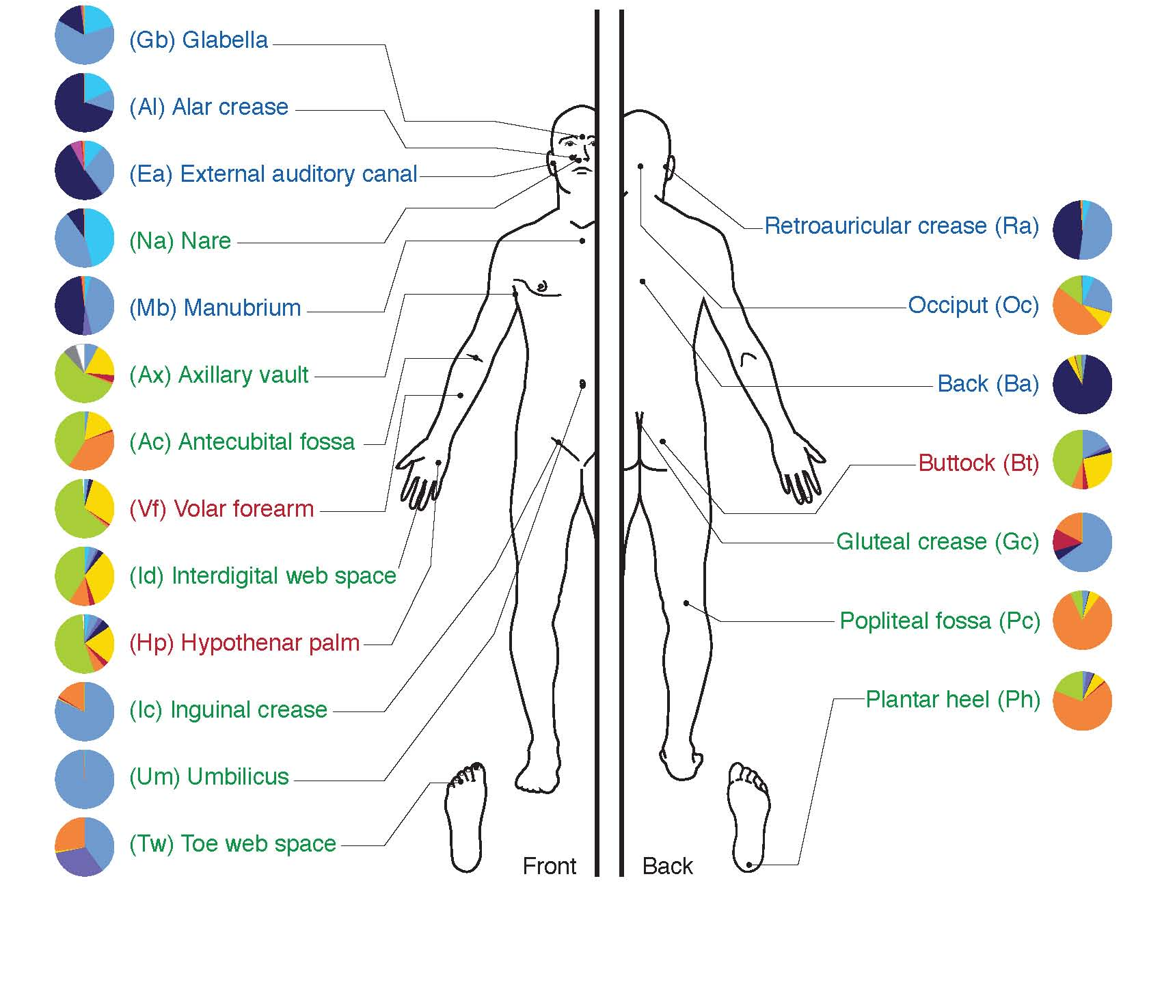
Where are the microbiota on the human body

Slide 6
The Gut Microbiome
Activity
Consider the environment where the highest bacterial load exists
Are these bacteria likely to be aerobic or anaerobic
What sources of food are present?
Predict how some change in diet might affect the kinds of bacteria present

Slide 7
How do we assess the microbiome

Slide 8
Factors that Modulate the Microbiome

Slide 9
How can we modify our gut microbial communities
Prebiotics
Selectively fermented ingredient that changes microbial composition and/or activity
Probiotics
Live bacteria meant to colonize

Slide 11
Key Roles of the Gut Microbiome
Development of the gastrointestinal system
Immune barrier function
Energy extraction

Slide 12
Immune Function

Slide 13
Microbiomes Differ in Lean and Obese Humans

Slide 14
Can the gut microbiome modify energy extraction?
Ridaura VK, Faith JJ, Rey FE, Cheng J, Duncan AE, Kau AL, Griffin NW, Lombard V, Henrissat B, Bain JR, Muehlbauer MJ, Ilkayeva O, Semenkovich CF, et al. Gut Microbiota from Twins Discordant for Obesity Modulate Metabolism in Mice. Science (80- ). 2013; 341: 1241214–1241214. doi: 10.1126/science.1241214.

Slide 15
What is the form of this energy?

Slide 16
Microbial Effects on Volumetric Diets

Slide 17
What can we digest, what can bacteria digest?
Humans make α-amylase (α-1,4-glucose linkages)
Some make β-galactosidase (lactase)
Porter, N. T. & Martens, E. C. The Critical Roles of Polysaccharides in Gut Microbial Ecology and Physiology. Annu Rev Microbiol 71, 349–369 (2017).

Slide 18
Two downsides of having excess digestion in the colon
Solutes in the colon retain water
diarrhea
Microbes that produce excessive gas
flatulence

Slide 19
Microbes and flatulence
Endogenous gas
largely in colon, from fermentation of soluble fibers:
Raffinose (Gal-Glu-Fru)
Beans, cabbage, brussel sprouts, asparagus
Stachyose (Gal-Gal-Glu-Fru)
Green beans, soybeans, beets, sweet potatoes
Verbascose (Gal-Gal-Gal-Glu-Fru)
Legumes
Lactose (Gal-Glu)
for those who are lactose intolerant)
Discuss why this would reduce gas formation?
Notes:
For example, need a-Galactosidase to digest the first three and b-Galactosidase to digest the last two

Slide 20
FODMAPS
Fermentable Oligosaccharides
Fructans (like inulin or levan)
Polyfructose with glucose at reducing end
Galactans
Polygalactose
Disaccharides
Mainly lactose
Monosaccharides and
Mainly fructose
Polyols
Sorbitol, mannitol, polyols (some fruits and sweeteners)
Galactan
Inulin – a Fructan
(β-2,1-polyfructose, with a glucose at reducing end)

Slide 21
Low FODMAP Diets

Slide 22
Microbes and Development of the GI System

Slide 23
Human Milk Oligosaccharides
Often our first probiotics
Promotes growth of particular bacterial species that can metabolize these carbohydrates
Lactose at one end

Slide 24
Should Public Policy Encourage Breastfeeding?
Positive Benefits
Negative Consequences
Nutrients not present not in formula or milk
Psychological bonding
Convenient and inexpensive
Sterile source of liquids (important for developing countries)
Can be inconvenient, requires lifestyle modifications
Can be painful
Stressful especially at beginning
Partner cannot breastfeed

Slide 25
Learning Objectives
Describe the commensurable relationship between humans and microbes, including major location-dependent microbiomes on the human body.
Evaluate the stability and malleability of the microbiome, in relationship to genetic or life-course dependent changes.
Consider the environmental factors that shape the gut microbial niche, and how that affects the kinds of bacterial species that flourish. Use this information to predict how bacteria species may be altered by diet.
Evaluate the role of fiber in providing fuel to the microbiome. Using the physical properties of polysaccharides in fiber, explain why these nutrients are particularly important for microbial function.
Explain the methods by which the microbiome is assessed, including the strengths and weaknesses of each methodology.
Describe the relationship between the gut microbiome and the immune system.
Compare descriptive and interventional studies of microbiota-disease relationships and use this information to consider the strength of the relationship.

